Slide 1
Data Structures 資料結構
Introduction to algorithm
Department of Computer Science
National Tsing Hua University

Slide 2
Definition of Algorithm
An algorithm is a finite set of instructions that accomplishes a particular task (problem) and satisfies the following criteria:
Input
Zero/more quantities are externally supplied.
Output
At least one quantity is produced.
Definiteness
Each instruction is clear and unambiguous.
Finiteness
Terminate after a finite number of steps.
Effectiveness:
Every instruction must be basic and easy to be computed.

Slide 3
Representation of Algorithms
Natural languages
English, Chinese, …etc.
A lot of sentences…
Graphic representation
Flowchart.
Feasible only if the algorithm is small and simple.
Programming language + few English
C++
Concise and effective!
Pseudo codes

Slide 4
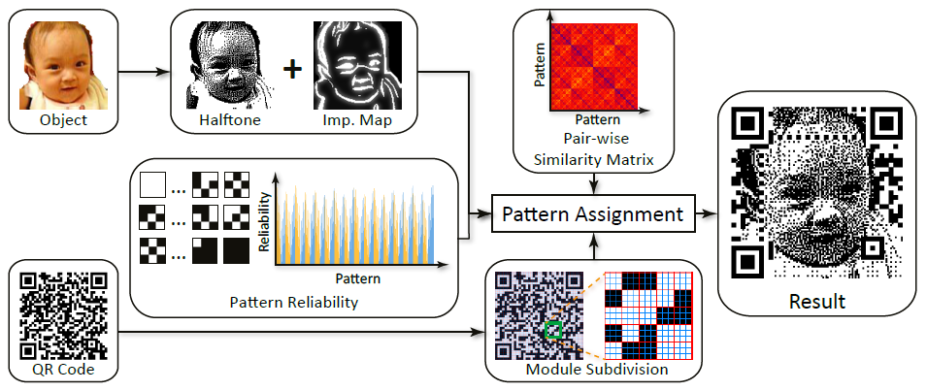
Example

Slide 5
Example: Binary Search
Problem statement: Assume we have n ≥ 1 distinct integers that are sorted in array A[0] … A[n-1]. Determine the existence of an integer x. If x=A[j], return index j; otherwise return -1.
A[0] A[1] A[2] A[3] A[4] A[5] A[6] A[7]
Eg. For x=9, return index 4;
For x=10, return -1.
A
1
3
5
8
9
17
32
50

Slide 6
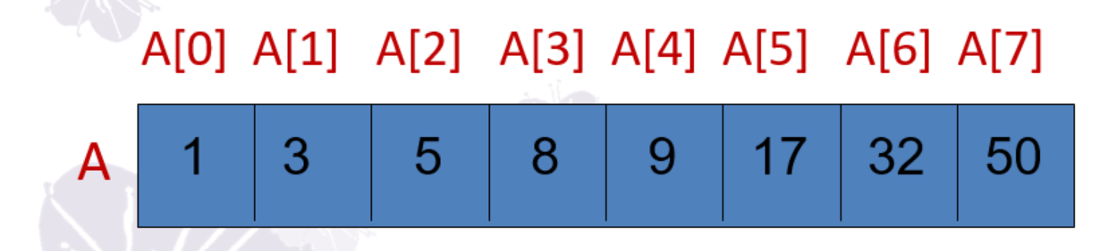
In Natural Language
Let left and right denote the left and right ends of the list with initial values 0 and n-1, respectively.
Let middle = (left+right) / 2 be the middle position in the list
Compare A[middle] with x and obtain three results:
X < A[middle]: x must be somewhere between 0 and middle-1. We set right to middle-1
X == A[middle]: We return middle
X > A[middle]: x must be somewhere between middle+1 and n-1. We set left to middle+1.
If x is not found and there are still integers to check, we recalculate middle and repeat the above comparison.

Slide 7
In Pseudo Codes
int BinarySearch(int *A, const int x, const int n)
{ int left=0, right=n-1;
while (left <= right)
{ // more integers to check
int middle = (left+right)/2;
if (x < A[middle]) right = middle-1;
else if (x > A[middle]) left = middle+1;
else return middle;
} // end of while
return -1; // not found
}

Slide 8
Recursive Algorithm
A powerful mechanism to make your algorithm or codes more clear.
Direct recursion :
Function calls itself directly.
E.g. funcA funcA.
Indirect recursion:
Function A calls other function B that invoke the function A itself.
E.g. funcA funcB funcA.

Slide 9
When shall we use recursion?

Slide 10
To Iterate is Human. Recursion, Divine.
遞迴只應天上有，凡人該當用迴圈

Slide 11
A Recursively Defined Problem
Binomial coefficient
C(n, m) =
can be computed by the recursive formula:
C(n, m) = C(n-1, m) + C(n-1, m-1)
where C(0, 0) = C(n, n) = 1.
n!
m! (n-m)!

Slide 12
Hints for Recursive Algorithms
To ensure a feasible recursive algorithm, you must stick the following principles:
Termination conditions:
Your function should return a value or stop at certain condition and stop calling itself.
Decreased Parameters
So that each call brings us one step closer to a termination condition.

Slide 13
There is a “While” statement
Replace with if-else and recursion
In Binary Search problem…
int BinarySearch(int *A, const int x, const int n)
{ int left=0, right=n-1;
while (left <= right)
{
…
}
return -1;
}

Slide 14
Recursive Binary Search
int BinarySearch(int *A, const int x, const int
left, const int right )
{ // Search the A[left],..,A[right] for x
if (left <= right) { // more integers to check
int middle = (left+right)/2;
if (x < A[middle])
return BinarySearch(A, x, left, middle-1);
else if (x > A[middle])
return BinarySearch(A, x, middle+1, right);
return middle;
} // end of if
return -1; // not found
}

Slide 15
A Running Example
Search for x=9 in array A[0]…[7] :
1st call: BinarySearch(A, 9, 0, 7)
2nd call: BinarySearch(A, 9, 4, 7)
3rd call: BinarySearch(A, 9, 4, 4)
return index 4.
A[0] A[1] A[2] A[3] A[4] A[5] A[6] A[7]
A
1
3
5
8
9
17
32
50
1st
3rd
2nd

Slide 16
Computing Binomial Coefficients
// Compute binomial coefficient C(n,m) recursively.
int BinoCoeff(int n, int m)
{
// termination conditions
if (m==n) then return 1;
else if (m==0) then return 1;
// recursive step
else
return BinoCoeff(n-1,m)+ BinoCoeff(n-1,m-1);
}

Slide 17
Criteria of a “Good” Program
Dose it do what you want to do?
Dose it work correctly?
Any documentation about how to use it?
Are functions created logically?
Is the code readable?
However, the above questions are HARD to achieve (at least when only DS is taught).
So, we focus on the “Performance” of the program

Slide 18
Performance Evaluation
Two criteria:
Space Complexity
How much memory space is used?
Time Complexity
How much running time is needed?
Two approaches:
Performance Analysis
machine independent
a prior estimate
Performance Measurement
machine dependent
a posterior testing

Slide 19
Performance Analysis
Space complexity : S(P) = C + S_{P}(I)
C is a fixed part:
Independent of the no. and the size of input and outputs.
Instruction space, space for simple variables, fixed-size structured variables, constants.
S_{P}(I) is a variable part:
Depends on the particular problem instance (I).
Space of referenced variable and recursion stack space (Instance Characteristics).

Slide 20
Instance Characteristics (I)
Commonly used characteristics (I) include the number and magnitude of the input and output of the problem.
We shall concentrate solely on estimating the 2nd part, S_{P}(I).
Ex1. sorting(A[], n) Then I= number of integers = n.
Ex2. Summing 1 to n, i.e., 1+2+3+… n Then I= value of n = n.

Slide 21
Space Complexity: Simple Function
float Abc(float a, b, c)
{
return a+b+b*c+(a+b-c)/(a+b)+4.00;
}
The input and output sizes do not change for different instances
I = a,b,c
C = space for the program + space for variables a, b, c, Abc = constant
S_{Abc}(I) = 0 (only fixed space requirements)
S(Abc) = C + S_{Abc}(I) = constant.
Notes:
The input and output sizes do not change with different inputs

Slide 22
Space Complexity : Iterative Summing
float Sum(float *A, const int n)
{ float s = 0;
for(int i=0; i<n; i++)
s += A[i];
return s;
}
The input and output sizes do not change for different instances, because C/C++ passes the array A with a pointer
I = n (number of elements to be summed)
C = constant
S_{Sum}(I) = 0 (A stores only the address of array)
S(Sum) = C + S_{Sum}(I) = constant.

Slide 23
Space Complexity : Recursive Summing
float Rsum(float *A, const int n)
{
if (n<=0) return A[0];
else return (Rsum(A, n-1) + A[n-1]);
}
I = n (number of elements to be summed)
C = constant
Each recursive call “Rsum” requires 4 ∙ ( 1 + 1 + 1) = 12 bytes.
Number of calls: Rsum(A, n) → Rsum(A,n-1) → … → Rsum(A, 0) ==> n+1 calls
S(Rsum) = C + S_{Rsum}(n) = const + 12 ∙ (n+1)

Slide 24
Performance Analysis
Time complexity : T(P) = C + T_{P}(I)
C is a constant part:
Compile time.
T_{P}(I) is a variable part:
Running time.

Slide 25
Performance Analysis
How to evaluate T_{P}(I) ?
Count every Add, Sub, Multiply, … etc.
Practically infeasible because each instruction takes different running time at different machine.
Use “program step” to estimate T_{P}(I)
“program step” = a statement whose execution time is independent of instance characteristics(I).
abc=a+b+b*c; → one program step
a=2; → one program step

Slide 26
Time Complexity : Iterative Summing
float Sum(float *A, const int n)
{ float s = 0; // 1 step
for(int i=0; i<n; i++) // n+1 steps
s += A[i]; // n steps
return s; // 1 step
}
I = n (number of elements to be summed)
T_{Sum}(I) = 1 + n+1 + n + 1 = 2n+3
T(Sum) = C + T_{Sum}(n) = constant+ (2n+3)

Slide 27
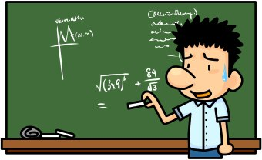
Time Complexity : Recursive Summing
float Rsum(float *A, const int n)
{
if (n<=0) // 1 step
return A[0]; // 1 step
else return (Rsum(A, n-1) + A[n-1]); // 1 step
}
I = n (number of elements to be summed)
T_{Rsum}(n) = ?

Slide 28
Time Complexity : Recursive Summing
float Rsum(float *A, const int n)
{
if (n<=0) // 1 step
return A[0]; // 1 step
else return (Rsum(A, n-1) + A[n-1]); // 1 step
}
I = n (number of elements to be summed)
Relation for T_{Rsum}(n) :
T_{Rsum}(0) = 2
T_{Rsum}(n) = 2 + T_{Rsum}(n-1) = 2 + ( 2 + T_{Rsum}(n-2) ) = … = 2n + T_{Rsum}(0) = 2n + 2

Slide 29
Time Complexity : Matrix Addition
void Add(int **a, int **b, int **c, int m, int n)
{
for(int i=0; i<m; i++) // m+1 steps
for(int j=0; j<n; j++) // m*(n+1) steps
c[i][j] = a[i][j]+b[i][j]; // m*n steps
}
I = m(rows), n (columns)
T_{Add}(I) =m+1+mn+m+mn =2mn + 2m +1
T(Add) = C + T_{Add}(m,n) = constant+ (2mn + 2m +1)

Slide 30
Observation on Step Counts
In the previous examples : T_{Sum}(n) = 2n + 3 steps T_{Rsum}(n) = 2n + 2 steps
Can we say that Rsum is faster than Sum ?
No!
The execution time of each step is different.
Instead, we are interested in “Growth Rate” of the program
“How the running time changes with changes in the instance characteristics?”

Slide 31
Program Growth Rate
In the Sum program, T_{Sum}(n) = 2n + 3 means when n is tenfold(10X), the running time T_{Sum}(n) is tenfold(10X).
We say that Sum program runs in linear time.
T_{Rsum}(n) =2n + 2 also runs in linear time.
We say T_{Sum}(n) and T_{Rsum}(n) have the same growth rate, and are equal in time complexity!

Slide 32
Asymptotic Notation
To make meaningful (but inexact) statements about the time and space complexities of a program.
Predict the growth rate.
Two programs with time complexity
P1: c₁ n² + c₂ n
P2: c₃ n
Which one runs faster?

Slide 33
Asymptotic Notation
Scenario 1: c₁ =1, c₂ =2, and c₃ =100
P1(n² + 2n) ≤ P2(100n) for n ≤ 98.
Scenario 2: c₁ =1, c₂ =2, and c₃ =1000
P1(n² + 2n) ≤ P2(1000n) for n ≤ 998.
No matter what values c₁, c₂ and c₃ are, there will be an n beyond which c₁ n² + c₂ n > c₃ n
Therefore, we should compare the complexity for a sufficiently large value of n!

Slide 34
Notation: Big-O (O)
Definition: f(n) = O(g(n)) iff these exist c, n₀>0 such that f(n) ≤ c g(n) for all n ≥ n₀.
Eg1. 3n + 2 = O(n)
3n+2 ≤ 4n for all n ≥ 2
Eg2. 100n + 6 = O(n)
100n+6 ≤ 101n for all n ≥ 6
Eg3. 10n² + 4n + 2 = O(n²)
10n² + 4n + 2 ≤ 11 n² for all n ≥5

Slide 35
Theorem 1.2
Theorem 1.2: If f(n) = a_{m}n^{m} + … + a₁n + a₀, then f(n) = O(n^{m}).
3n + 2 = O(n)
100n + 6 = O(n)
10n² + 4n + 2 = O(n²)
6n⁴ + 1000 n³ + n² = O(n⁴)
Leading constants and lower-order terms do not matter.

Slide 36
Theorem 1.2
Proof:
f(n) = a_{m}n^{m} + … + a₁n + a₀
≤ |a_{m}|n^{m} + … + |a₁|n + |a₀|
≤ n^{m} (|a_{m}| + … + |a₁|+|a₀|)
≤ n^{m} c for n ≥ 1
So, f(n) = O(n^{m}).

Slide 37
More Examples
n² - 10n – 6 = O(?)
n + log n = O(?)
n + n log n = O(?)
n² + log n = O(?)
2^{n} + n¹⁰⁰⁰⁰ = O(?)
n⁴ + 1000 n³ + n² = O(n⁴), True or false?
n⁴ + 1000 n³ + n² = O(n⁵), True or false?
Notes:
n⁴ + 1000 n³ + n² = O(n⁵)
f(n) = n⁴ + 1000 n³ + n²
g(n) = n⁵
c=1, n0=11

Slide 38
Answers
n² - 10n – 6 = O(n²)
n + log n = O(n)
n + n log n = O(n log n)
n² + log n = O(n²)
2^{n} + n¹⁰⁰⁰⁰ = O(2^{n})
n⁴ + 1000 n³ + n² = O(n⁴), True.
n⁴ + 1000 n³ + n² = O(n⁵), True.

Slide 39
Properties of Big-O
f(n) = O(g(n)) states only that g(n) is an upper bound of f(n).
n = O(n) = O(n^{2.5}) = O(n³)
However, we want g(n) as small as possible!
Big-O also refers to worst-case running time of a program.
f(n) = O(g(n)) doesn’t mean the g(n) = O(f(n))

Slide 40
Naming Common Functions
Complexity | Naming
O(1) | Constant time
O(log n) | Logarithmic time
O(n log n) | O(log n) ≤ . ≤ O(n²)
O(n²) | Quadratic time
O(n³) | Cubic time
O(n¹⁰⁰) | Polynomial time
O(2^{n}) | Exponential time
When n is large enough, the latter terms take more time than the former ones.

Slide 41
Plot of Common Function Values

Slide 42
Running Times on Computers
 |  | f (n)
 | n | n | n log₂ n | n² | n³ | n⁴ | n¹⁰ | 2^{n}
 | 10 20 30 40 50 100 10³ 10⁴ 10⁵ 10⁶ | .01 μs .02 μs .03 μs .04 μs .05 μs .10 μs 1 μs 10 μs 100 μs 1ms | .03 μs .09 μs .15 μs .21 μs .28 μs .66 μs 9.96 μs 130 μs 1.66 ms 19.92ms | .1 μs .4 μs .9 μs 1.6 μs 2.5 μs 10 μs 1 ms 100 ms 10s 16.67m | 1 μs 8 μs 27 μs 64 μs 125 μs 1ms 1s 16.67m 11.57d 31.71y | 10 μs 160 μs 810 μs 2.56ms 6.25ms 100ms 16.67m 115.7d 3171y 3.17*10⁷y | 10s 2.84h 6.83d 121d 3.1y 3171y 3.17*10¹³y 3.17*10²³y 3.17*10³³y 3.17*10⁴³y | 1μs 1ms 1s 18m 13d 4*10¹³y 32*10²⁸³y
μs = microsecond = 10⁻⁶second; ms =milliseconds = 10⁻³seconds s = seconds; m = minutes; h = hours; d = days; y = years;

Slide 43
Compute Running Time in Big-O
Two approaches to compute the time complexity of a program in big-O
Approach 1: Step1: Compute the total step-count. Step2: Take big-O using theorem 1.2.
Approach 2: Step1: Take big-O on each step. Step2: Sum up the big-O of all steps.

Slide 44
Rule of Sum
If f₁(n) = O(g₁(n)), and f₂(n)=O(g₂(n)),
then f₁(n) + f₂(n) = O(max(g₁(n), g₂(n)).
Ex. f₁(n) = O(n), f₂(n) = O(n²)
Then f₁(n) + f₂(n) = O(n²).
Ex. f₁(n) = O(n), f₂(n) = O(n)
Then f₁(n) + f₂(n) = O(n).
Used to compute the sequential statements in a program.

Slide 45
Rule of Product
If f₁(n) = O(g₁(n)), and f₂(n)=O(g₂(n)), then f₁(n) ∙ f₂(n) = O(g₁(n) ∙ g₂(n)).
Eg. f₁(n) = O(n), f₂(n) = O(n)
Then f₁(n) ∙ f₂(n) = O(n²).
Used in time analysis of nested loops.
for (i=0; i<n; i++) { // O(n)
for (j=0; j<n; j++) // O(n)
sum := sum + 1; // O(1)
}
f(n) = O(n ∙ n ∙ 1) = O(n²).

Slide 46
Complexity of Binary Search
int BinarySearch(int *A, const int x, const int n)
{ int left=0, right=n-1;
while (left <= right)
{ // more integers to check
int middle = (left+right)/2;
if (x < A[middle]) right = middle-1;
else if (x > A[middle]) left = middle+1;
else return middle;
} // end of while
return -1; // not found
}
O(?)
O(1)
O(1)
O(1)
O(1)

Slide 47
Complexity of Binary Search
Analysis of the while loop:
Iteration 1: n values to be searched
Iteration 2: n/2 left for searching
Iteration 3: n/4 left for searching
…
Iteraton k+1: n/(2^{k}) left for searching
When n/(2^{k}) = 1, searching must finish.
That is n = 2^{k}
==> k = log₂ n
Hence, worst-case running time of binary search is O(log₂ n).

Slide 48
Notation: Omega (Ω)
Definition: f(n) = Ω(g(n)) iff these exist c, n₀>0 such that f(n) ≥ c g(n) for all all n ≥ n₀.
Eg1. 3n + 2 = Ω(n)
since 3n+2 ≥ 3n for all n ≥ 1
Eg2. 100n + 6 = Ω(n)
since 100n+6 ≥ 100 n for all n ≥ 1
Eg3. 10n² + 4n + 2 = Ω(n²)
since 10n² + 4n + 2 ≥ n² for all n ≥1
The lower bound or best-case running time

Slide 49
Notation: Theta(Θ)
Definition: f(n) = Θ(g(n)) iff f(n) = O(g(n)) and f(n) = Ω(g(n)).
Ex1. 3n + 2 = Θ(n)
Ex2. 100n + 6 = Θ(n)
Ex3. 10n² + 4n + 2 = Θ(n²)
The tight bound or average-case running time

Slide 50
Performance Measurement
Obtain actual space and time requirement when running a program.
How to do time measurement in codes ?
Method 1: Use clock(), measured in clock ticks
Method 2: Use time(), measured in seconds
To time a short program, it is necessary to repeat it many times, and then take the average.

Slide 51
Performance Measurement
Method 1: Use clock(), measured in clock ticks
#include <time.h>
void main()
{
clock_t start = clock();
// main body of program comes here!
clock_t stop = clock();
double duration = ((double) (stop-start))
/ CLOCKS_PER_SEC;
}

Slide 52
Performance Measurement
Method 2: Use time(), measured in seconds
#include <time.h>
void main()
{
time_t start = time(NULL);
// main body of program comes here!
time_t stop = time(NULL);
double duration = (double) difftime(stop,start);
}

